Slide 1

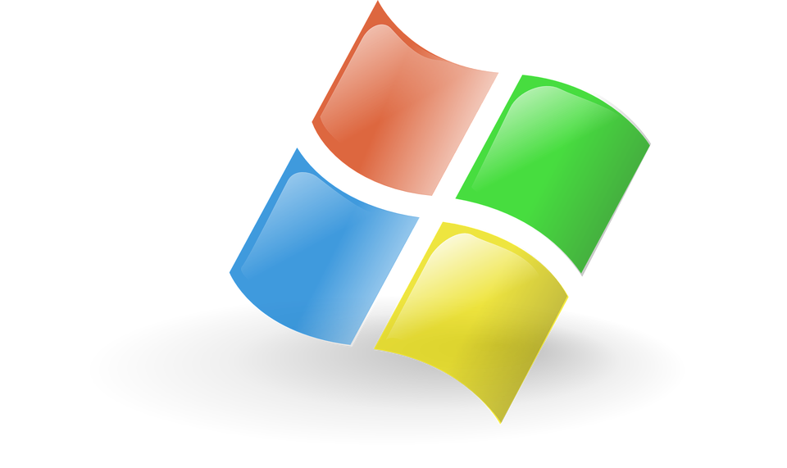

Microsoft Corporation - Risk Analysis for Equity Investors
Microsoft (MSFT) is a leading global tech company with AAA/Aaa credit ratings in 2024
Data sources: Microsoft’s 2024 annual report, Yahoo Finance.
Part 1
Fundamental Risks
Division | High ←… Moderate …→ Low
Business Risk | ● | ● | ◉ | ● | ●
Geographic Risk | ● | ● | ◉ | ● | ●
Political Risk | ● | ● | ◉ | ● | ●
Reputation & ESG Risk | ● | ● | ● | ◉ | ●
Competitions from Microsoft such as Google, Apple, and Amazon
Technological Disruption
more than 190 different countries
50% of Revenue is from US
Regulatory burdens (GDPR, CCPA), US-China tensions
AI ethics, environmental impact

Slide 2
Financial Risks
✅ Liquidity
exceeds industry benchmarks 1.0
short-term obligations
✅ Profitability
strong pricing power & efficiency
Better than competitors
Strong ROE & ROA reduce business risk
LIQUIDITY | MSFT | AAPL | GOOG | PROFITABILITY | MSFT | AAPL | GOOG
 |  |  |  | Gross Margin | 69.76% | 46.52% | 58.20%
Current Ratio | 1.275 | 0.92 | 1.84 | Operating Margin | 44.64% | 31.76% | 32.11%
Quick Ratio | 1.265 | 0.88 | 1.84 | Net Margin | 35.43 | 24.30% | 28.60%
Cash Ratio | 0.6 | 0.37 | 1.07 | ROE % | 34.34 | 141.94 | 33.02
 |  |  |  | ROA% | 18.37 | 27.76 | 23.78
LEVERAGE & |  |  |  | BANKRUPTCY ASSESSMENT
SOLVENCY RATIOS
Cash to Debt | 1.15 | 0.56 | 3.76 | Z score | 9.57 | 9.45 | 12.5
Equity to Asset | 0.57 | 0.19 | 0.72
Debt to Equity | 0.21 | 1.45 | 0.08
Interest Coverage Ratio | 43.97 | N/A | N/A
Part 2
✅ Leverage & Solvency
Low debt reliance
high equity financing
44 times of its interest expenses
✅ Bankruptcy Risk
Very low, stable financial position
Greater than Benchmark 10

Slide 3
Financial Risks
Risk Category | Hypothetical Change | Impact on Financials
Interest Rate Risk | 100 basis point increase in U.S. Treasury rates ▲ | ($1.34B) ▼ decrease in fair value
Foreign Exchange Risk | 10% decrease in foreign exchange rates ▼ | ($9.6B) ▼ decrease in revenue
Foreign Exchange Risk | 10% decrease in foreign exchange rates ▼ | ($38M) ▼ decrease in fair value (investment)
✅ Interest Rate Risk
100-bps hike → $1.34B fair value loss
✅ FX risk
10% decrease in Fx rate → Decrease is High for revenue, low for investments
Part 3
Share Price Risks
Metric | Microsoft (MSFT) | Apple (AAPL) | Alphabet Inc. (GOOG | S&P 500(^GSPC)
Daily Volatility | 1.92% | 2.00% | 2.04% | 1.34%
Annualized Volatility | 30% | 31.69% | 32.39% | 21.35%

Slide 4
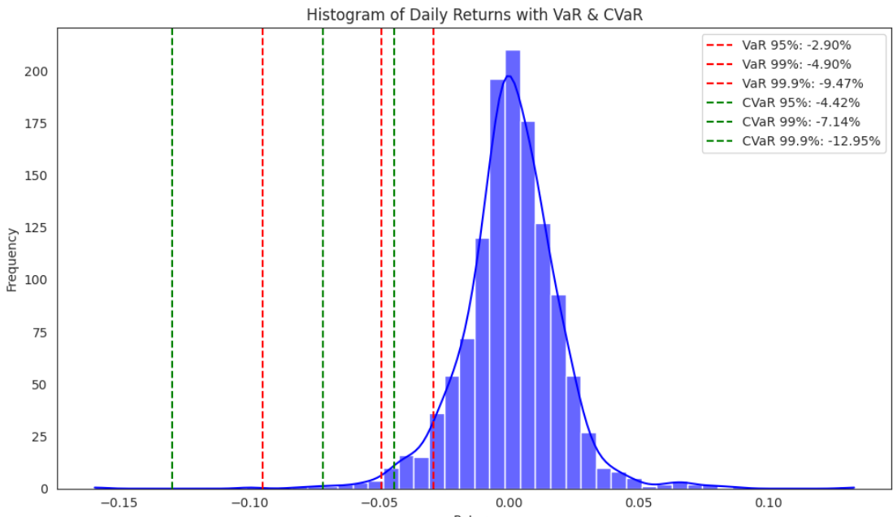
Share Price Risks
GARCH (1,1) Model Analysis
VAR 95% : -0.029
α: 0.105 ,β: 0.843
Long-run Variance: 0.000334
Annualized Volatility Estimate: 1.83% per day
α + β = 0.948,
CVAR 95% : -0.042
Part 4
Conclusion & Investment Outlook
Microsoft remains a strong investment choice but has key risks.
Main risks: Competition, regulatory challenges, market volatility.
Moderate share price risk: Requires diversification for downside protection.

Slide 5


